Slide 1
DIGITAL PORTFOLIO
STUDENT NAME: BARATH B
REGISTER NO AND NMID:F910769F6B90706BF3243F787455332F
DEPARTMENT: II BCA
COLLEGE: PRINCE SHREE VENKATESHWARA ARTS & SCIENCE COLLEGE/MADRAS UNIVERSITY

Slide 2
PROJECT TITLE
DIGITAL PORTFOLIO

Slide 3
AGENDA
1. Problem Statement
2. Project Overview
3. End Users
4. Tools and Technologies
5. Portfolio design and Layout
6. Features and Functionality
7. Results and Screenshots
8. Conclusion9. Github Link

Slide 4
Problem Statement
Many students and developers lack a personal portfolio to showcase their skills, projects, and achievements online.This project solves the problem by providing a simple, modern, and interactive portfolio website.

Slide 5
Project Overview
The portfolio website is designed using HTML, CSS, and JavaScript.It highlights personal information, skills, projects, and a contact form for easy communication.

Slide 6
End Users
Recruiters and hiring managers
Potential collaborators
Academic peers and mentors
General audience interested in web development

Slide 7
Tools and Technologies
HTML5, CSS3, JavaScriptVisual Studio Code (IDE)GitHub (version control & hosting)Modern CSS styling (gradients, flexbox)Browser Developer Tools for debugging

Slide 8
Portfolio Design and Layout
The website follows a clean, modern design with sections:
Navigation bar
Hero section (name & title)
About Me sectionSkills with progress bars
Projects with descriptions
Contact form
Footer

Slide 9
Features and Functionality
Responsive design for all devices
Interactive navigation menu
Skills progress bar visualization
Contact form with validation & submission alert
Modern color gradients & styling
Simple and user-friendly interface

Slide 10
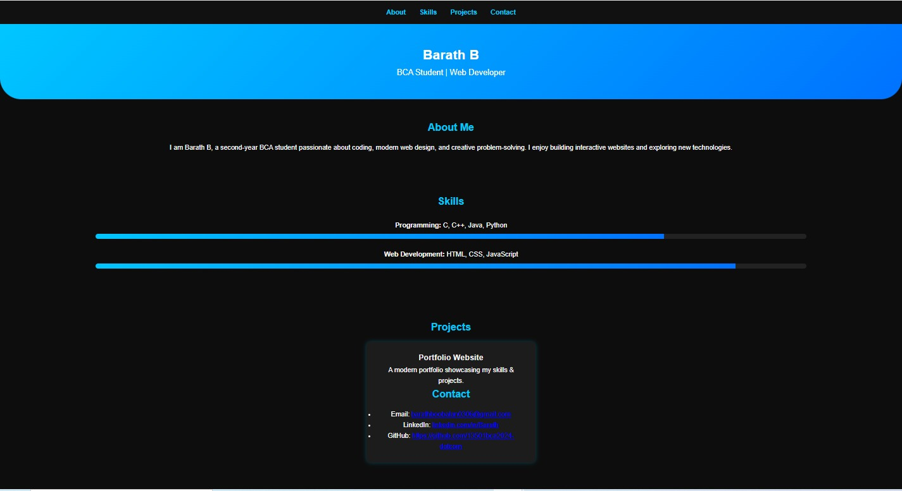
Results and Screenshots

Slide 11
Conclusion
portfolio website successfully demonstrates web development skills and provides a strong personal branding tool.It is extendable with more projects, blogs, or integrations in the future.

Slide 12
Github Link:
https://13501bca2024-dotcom.github.io/My-portfolio/

